Slide 1
Project Portfolio for Tshegofatjo Peter Rakoma ID Number : 940822 5818 083 Cell : 079 0974 928 Email: rakomatp94@gmail.com
_________________________________________________________________________________________
Project Name: PayYouPayMe
Programming language: C#
Database type: SQLite
Platform: Windows Phone 8.1

Slide 2
Introduction
Description of application
My PayYouPayMe application is the best at management of personal debt management so that it is easy for individuals to manage their debts that is who they owe money and who owes them. It makes it easy to locate creditors and debtors, quickly locate debtors and creditors and quickly update debtors and creditors.
Story Matrix
How someone can use the application
Peter is an average person who likes to keep track of his finances. He is both a creditor and debtor depending on his financial circumstances. He likes to keep track of who he is owing and how much. When he is taking a loan he records the loan details as well as when he is offering a loan. Sometimes he forgets who he has landed money to or from. So he records every debtor or creditor and takes them pictures.
Peter spends time at home and when he is planning his budget he wants to keep up with how much he is owing and how much he is owed. When he is paying a creditor or paid by a debtor he update how much is paid/paying by that creditor or debtor. He likes to send notifications to his debtors or creditors so he sends them SMS, e-mail or calls them.

Slide 3
Software requirements and Development
Software requirements
Windows phone 8.1
Development
This application was developed for Windows phone 8.1 using Microsoft Visual studio 2013 ultimate.
It was programmed using the C# programming language.
It was designed using XAML (Extensible Application Markup Language).
The database implemented is SQLite .
Frame work used is Entity Framework 7.
Skills applied
Object Oriented Programming
Analysis, database design and implementation.
User interface design vs User experience
Debugging and testing

Slide 4
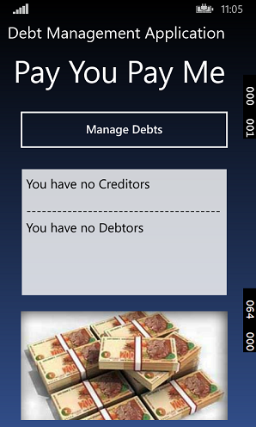
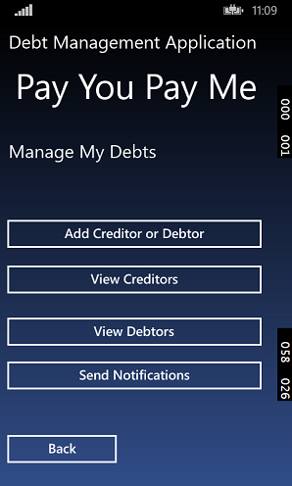
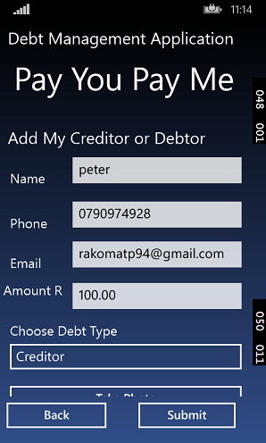
User Manual: PayYouPayMe
Debt management page: you can choose any option
Provide information for Debtor or Creditor
Application main page: navigate to Mange Debts

Slide 5
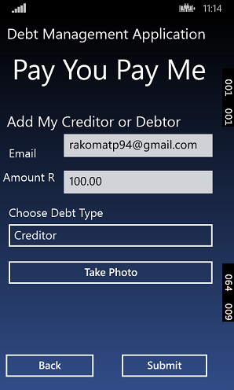
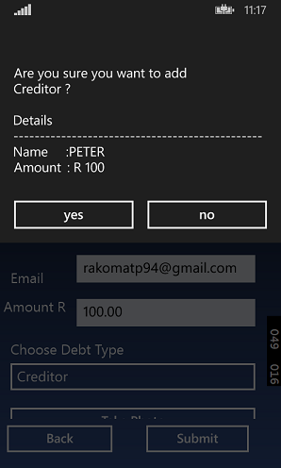
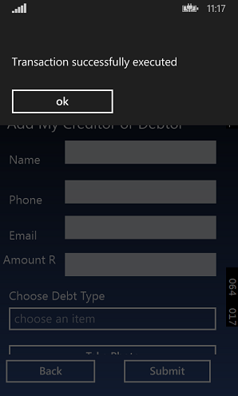
User Manual: PayYouPayMe cont…
Click ok
Click yes to proceed or no to cancel
Click submit to save Debtor or Creditor information

Slide 6
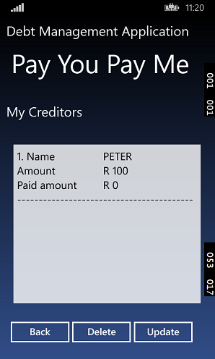
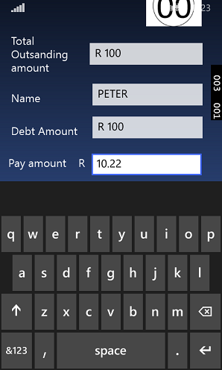
User Manual: PayYouPayMe cont…
Provide payment amount to creditor
Click to view Creditors
Click to update creditor information

Slide 7
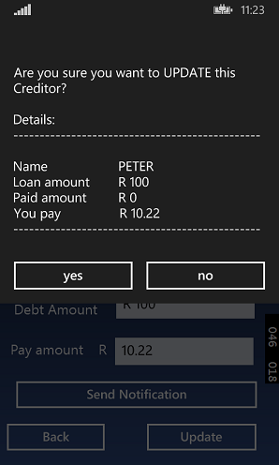
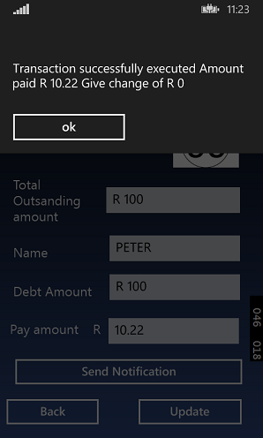
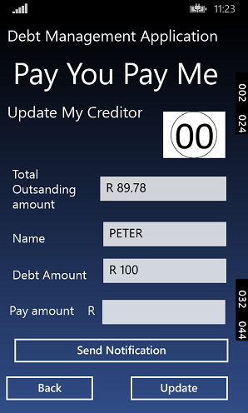
User Manual: PayYouPayMe cont…
Click yes to proceed or no to cancel
Click ok
Updated information after transaction

Slide 8

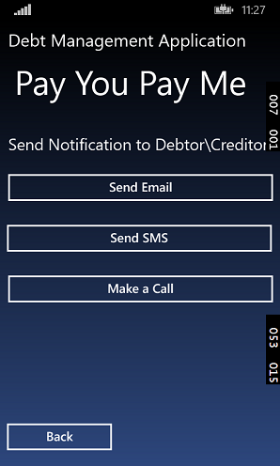
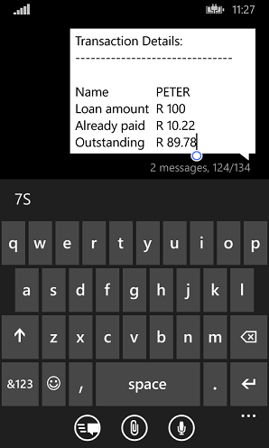
User Manual: PayYouPayMe cont…
SMS information automatically generated by application
Click to navigate to Send Notification page
Send notification page: you can choose any option
Click to navigate to Send SMS

Slide 9
End of Project Portfolio

